Slide 1
Microcontroller-8051

Slide 2

Micro-controller-8051

Slide 3
Micro-controller-8051
The Key features of the 8051 Microcontroller –
4 KB on-chip ROM (Program memory).
128 bytes on-chip RAM (Data memory).
The 8-bit data bus (bidirectional).
16-bit address bus (unidirectional).
Two 16-bit timers.
Instruction cycle of 1 microsecond with 12 MHz crystal.
Four 8-bit input/output ports.
8051 has two external and three internal interrupts.
8051 microcontroller specifies some special function features like UARTs, ADC, Op-amp, etc.

Slide 4
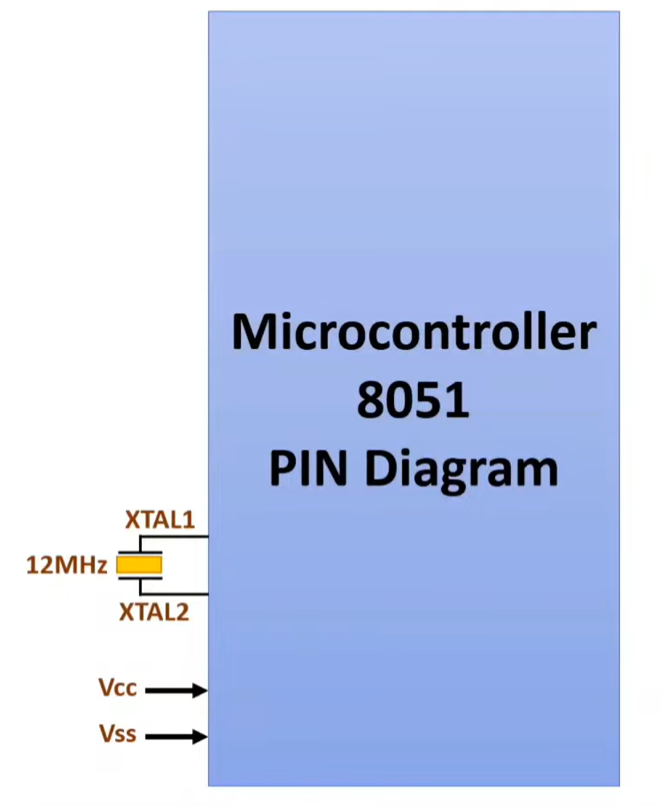
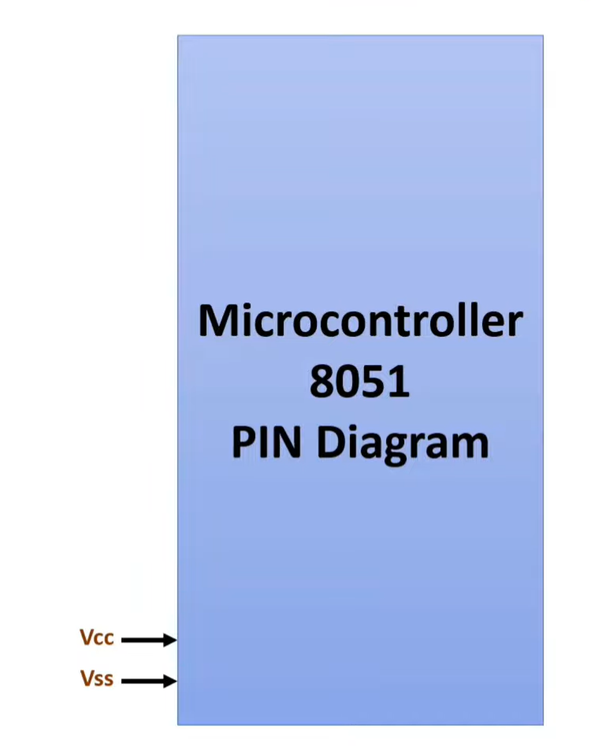
Pin configuration of 8051

Slide 5
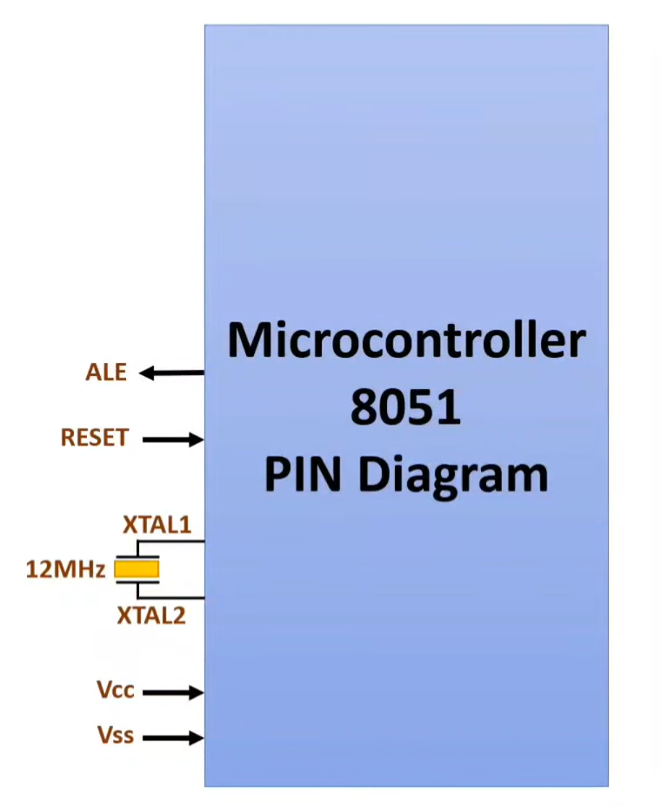
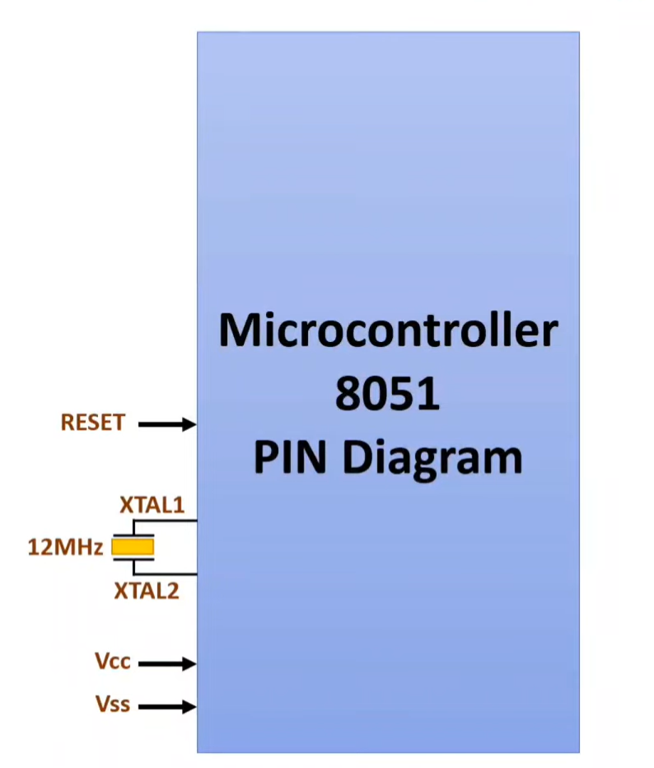
Pin configuration of 8051

Slide 6
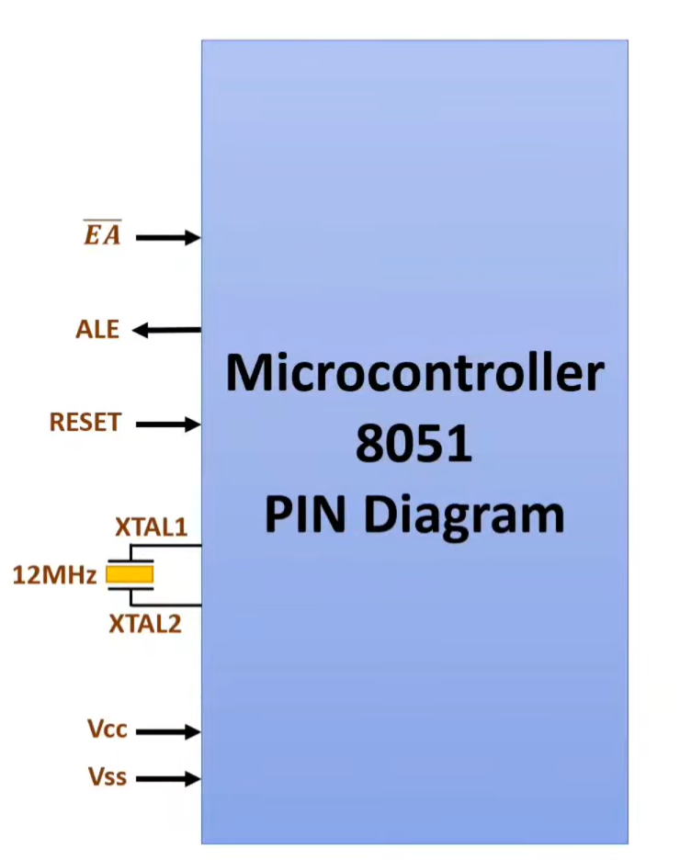
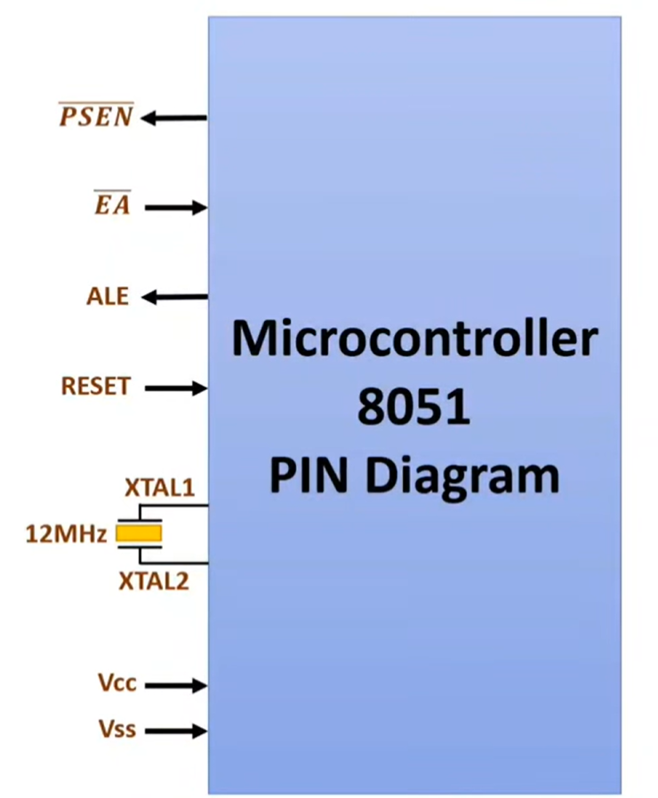
Pin configuration of 8051

Slide 7
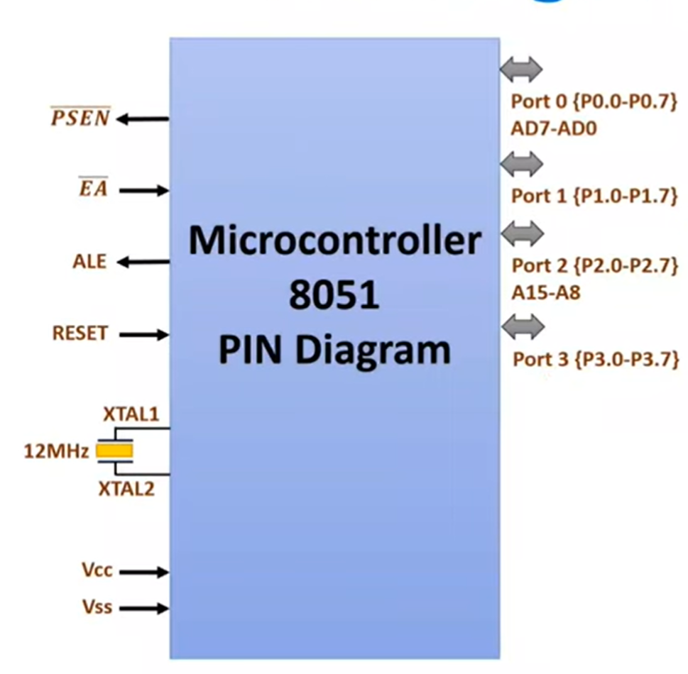
Pin configuration of 8051

Slide 8
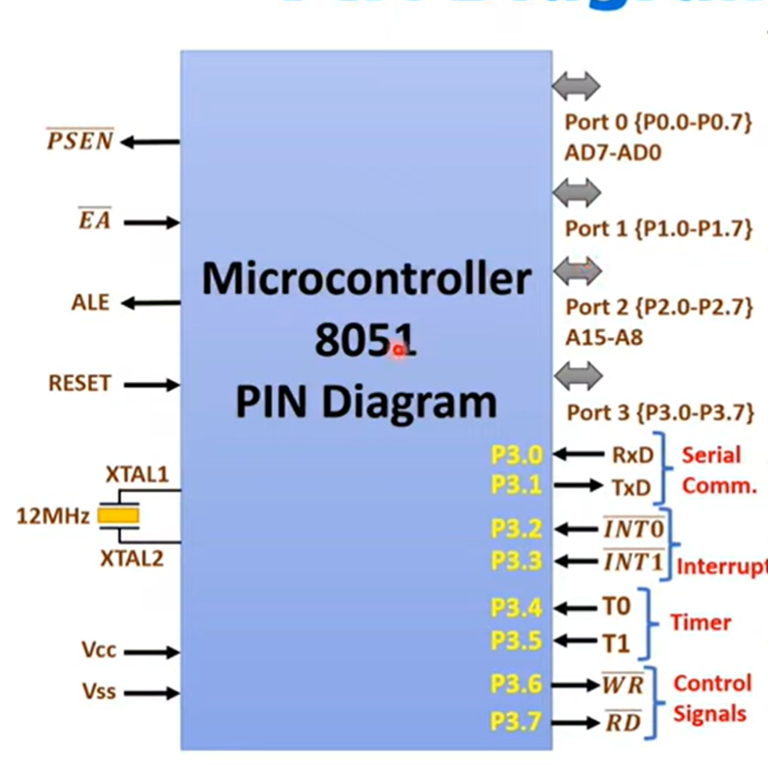
Pin configuration of 8051

Slide 9
VCC: This pin is connected to the power supply and provides a voltage of +5V to the microcontroller.
GND: This pin is connected to the ground and serves as the reference voltage for the microcontroller.
XTAL1 and XTAL2: These pins are used for connecting an external crystal oscillator that provides the clock signal for the microcontroller. 12MHZ
Reset: This pin is used for resetting the microcontroller. A high pulse on this pin resets the microcontroller to its initial state.(PC=0000H)
Port 0: This is an 8-bit bidirectional input/output port that can be used for interfacing with external devices.(AD0-AD7)
Port 1: This is an 8-bit bidirectional input/output port that can be used for interfacing with external devices.
Port 2: This is an 8-bit bidirectional input/output port that can be used for interfacing with external devices.(A8-A15)
Port 3: This is an 8-bit bidirectional input/output port that can be used for interfacing with external devices.(MULTIPLE FUNCTIONS)
INT0: This is an external interrupt 0 input pin.
INT1: This is an external interrupt 1 input pin.

Slide 10
T0: This is an external timer 0 input pin.
T1: This is an external timer 1 input pin.
WR: This is the write signal for external memory.(RAM OPERATION)
RD: This is the read signal for external memory .(RAM OPERATION)
ALE: This is the address latch enable signal that is used to latch the address for external memory.(ALE=1:Address, ALE=0: Data)
PSEN: This is the program store enable signal that is used for accessing the program memory.
17-24. Address bus: These pins are used for transmitting the address information to the external memory.
25-32. Data bus: These pins are used for transmitting the data between the microcontroller and external memory.
EA: This is the external access enable signal that is used for selecting the program memory.
36-39. XTAL: These pins are used for connecting an external crystal oscillator.

Slide 11
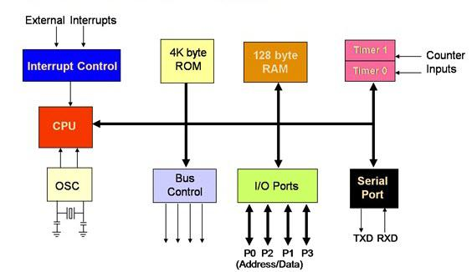
8051 ARCHITECTURE

Slide 12
Application of 8051 Microcontroller
Automation: The 8051 microcontroller is widely used in automotive applications. They are widely used in hybrid vehicles to control engine options. In addition, functions such as cruise control and anti-brake mechanism have been further enhanced thanks to the integration of a microcontroller.
Medical Devices: Convenient medical devices such as blood glucose and blood pressure monitors contain microcontrollers that display measurements.
Energy management: Competent measurement systems support energy consumption calculations in home and industrial environments. These measuring systems are prepared by integrating a microcontroller.
Touch Screen: Many microcontroller vendors incorporate touch functionality into their designs. Portable devices such as media players, and gaming devices.

